Slide 1
Unsupervised Morphological Segmentation and Paradigms for Spelling Check
By Monica Vashu Kherajani
Vaidehi Ajay Dharkar

Slide 2
Abstract
Grouping of various morphosyntactically similar words could reveal consistent patterns in the way the words are inflected in a language. In this project, we propose a method that takes no prior knowledge of the language and finds such similar groups. Groups are based purely on the structuring of inflectional forms in that language. Unsupervised method of learning called Agglomerative Clustering is adopted to cluster based on the features extracted from the words. The clustering algorithm measures and groups the words based on the similarity of their structures of inflectional forms. The results obtained are quite natural to human interpretation. Thus defining the rules that can be used to detect the errors in various inflected words of the language.

Slide 3
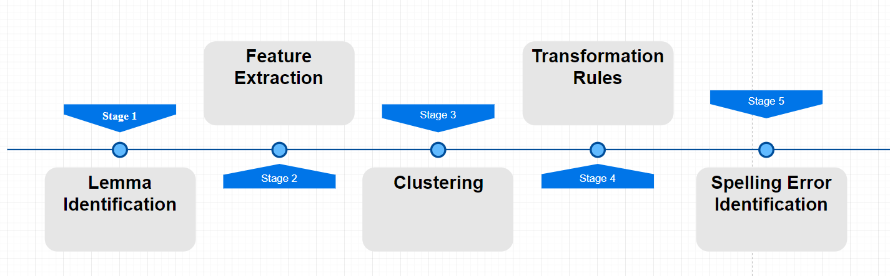
Overall process

Slide 4
Overall process
Overall Process:
1. Lemma Identification
2. Feature Extraction
- The concatenated suffixes are identified as features for that particular lemma form.
3. Clustering
- Lemma having similar feature patterns are clustered together using hierarchical clustering.
4. Transformation Rules
- As all lemma in a cluster are having similar pattern of suffixes. Transformation rules for each cluster are idenified.
5. Spelling Error Identification
- These rules are applied on testing dataset to find inconsistencies in the way the words are inflected.

Slide 5
Lemma Identification
Lemma which is considered as largest common substring from the word and its inflected forms is separated from its suffixes.
E. g: Following inflations of the word “Snuffle” are present: “snuffles, snuffled, snuffling”
We’ll consider longest common substring among the inflations:
i. e. ‘snuffl’ as lemma and ‘es’, ‘ed’, ‘ing’ as its suffixes.

Slide 6
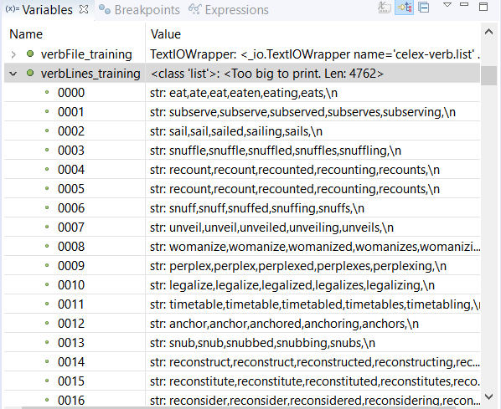
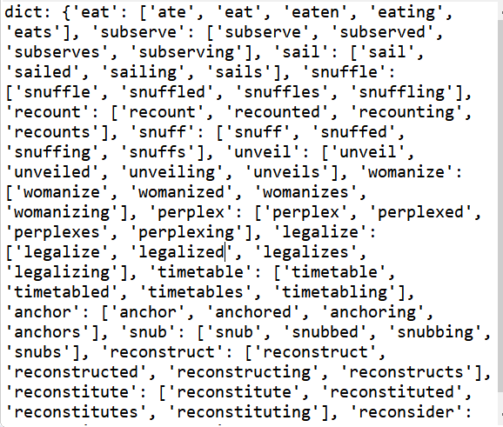
Lemma Identification

Slide 7
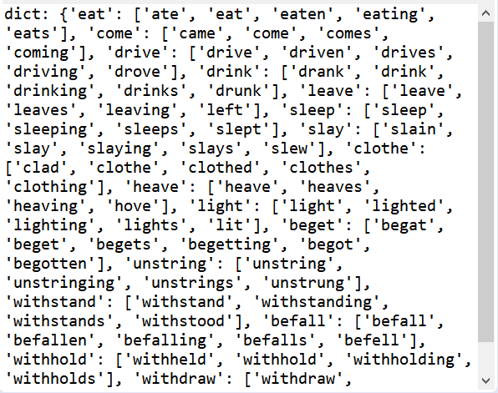
Irregular words

Slide 8
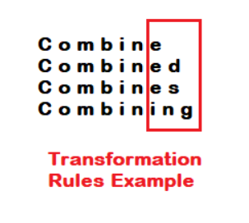
Transformation rules- Alignment

Slide 9
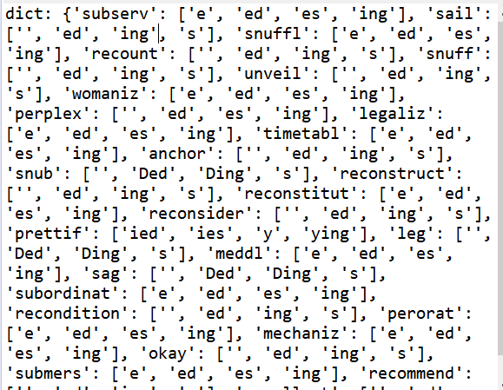
Extraction of rules

Slide 10
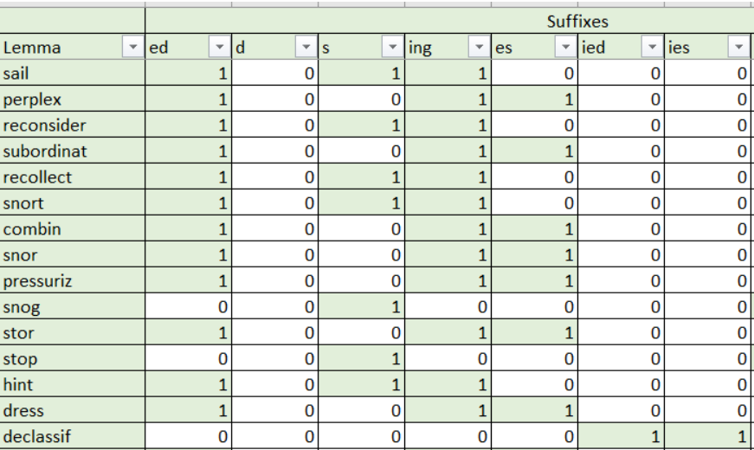
Feature Matrix:

Slide 11
Our Approach for clustering
- Feature matrix is provided to the hierarchical clustering algorithm. (Agglomerative clustering)
- This algorithm recognizes the patterns in the suffixes of similar words and groups them into one cluster.
- Desired number of clusters are provided while passing the feature matrix to clustering algorithm. Number of clusters are altered according to the accuracy of the output provided by agglomerative clustering.
- Here in case of our dataset we got best result with 10 clusters.

Slide 12
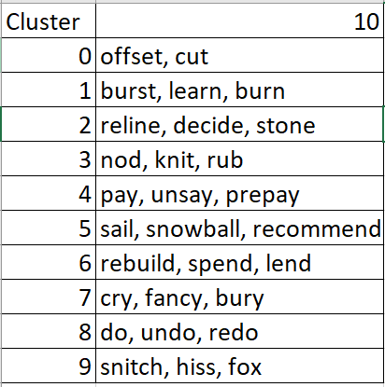
Cluster representatives

Slide 13
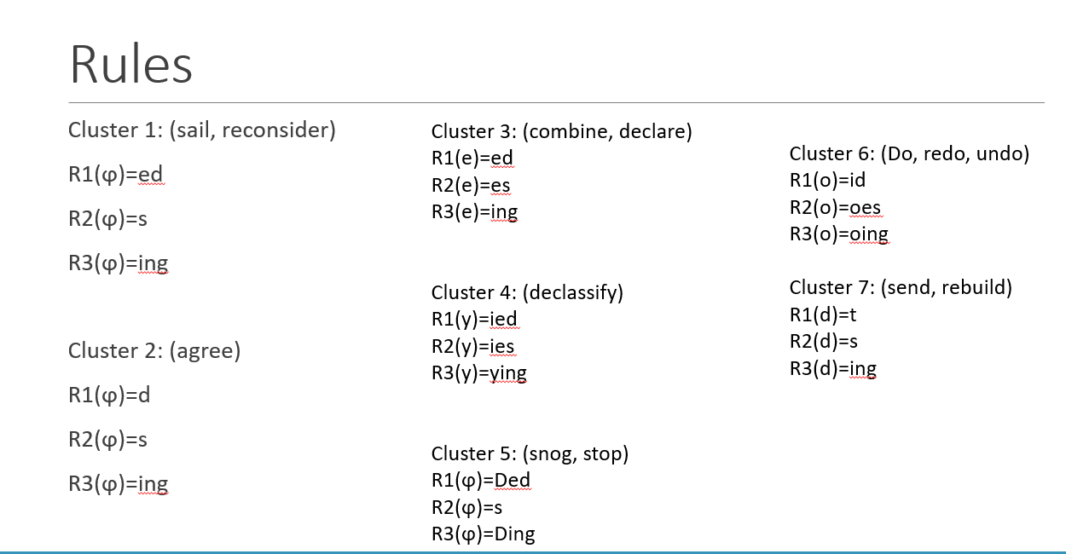

Slide 14
Testing
- The test data undergoes similar preprocessing stages and lemma is extracted.
- These test lemma are assigned to their respective clusters.
- Predicted inflations of test lemma are found by concatenating the suffix rules of the cluster to which the lemma belongs.
- If the test inflations are different than predicted inflated forms, the word is identified to be incorrect.

Slide 15
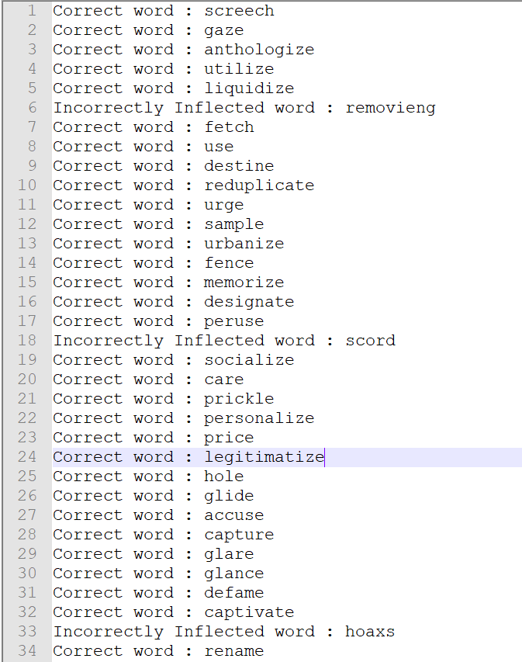
Sample output

Slide 16
Future work:
Dealing with irregular words: This approach will work successfully on regular words(like mentioned in the table in previous slide). However, there is a class irregular words like - catch-> caught, bring-> brought, fight->fought which we need to consider in a different fashion for clustering.

